Slide 1
Object Oriented Design
Ramaswamy Krishnan Chittur

Slide 2
Evolution of programming models
Goal:
Improving management of large software systems.
Programming models:
SP - Structured Programming:
Decomposes large monolithic programs into modules using functional decomposition.
OOD - Object Oriented Design:
Associates data with functions allowed to act on that data, via ‘objects’.
COM - Component Object Model:
Reduces interdependencies between objects, using interfaces and object factories for isolation.
AOP - Aspect Oriented Programming:
Separates program’s primary functionality from needed support infrastructure to simplify a program’s logic.

Slide 3
Object Oriented Design (OOD)
Simulates real-world via the concept of ‘objects’ that contain data and functions.
The four basic principles of object-oriented programming are:
Abstraction
Encapsulation
Inheritance
Polymorphism
Reference:
Object-Oriented Programming (C#) | Microsoft Docs
Exercises:
Try the exercises at Object-Oriented Programming (C#) | Microsoft Docs
Consider a class that manages persistence:
Provides the following functions:
void Store(string id, string value)
string Retrieve(string id)
Implement three different classes that will persist the data using: XML, JSON and Plain Text.

Slide 4
SOLID
The Single-responsibility principle: Every class should have only one responsibility.
The Open–closed principle: Open for extension, closed for modification.
The Liskov substitution principle: Clients that use pointers to base classes must be able to use objects of derived classes without knowing it.
The Interface segregation principle: Clients should not need to depend upon interfaces that they do not use.
The Dependency inversion principle: Use abstractions, promote loose coupling.
Reference: Here

Slide 5
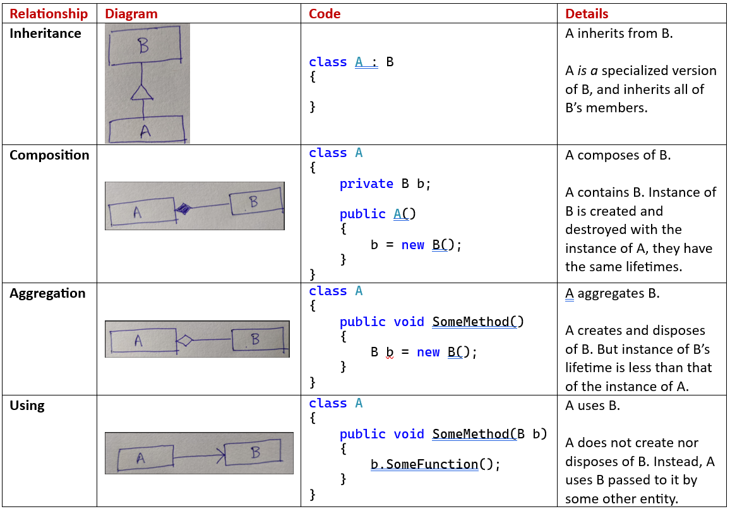
Class relationships

Slide 6
Software Contracts
Interfaces and contracts:
Car <-> Axle <-> Wheel
Door <-> Hinge <-> Wall
Why do we need a contract?
Componentization to develop independently and concurrently.
How do we specify a software contract?
Through an interface
Example:
User interface <-> Communication Interface <-> Networking.
In the above example, the contract is simple. Send, Receive.
Send takes in a message and address from the UI and passes it to the networking component.
Receive dynamically shares with the UI, the message received by the networking component.
Client is agnostic to implementation. Communication channel can use sockets, named pipes, tcp, http etc. UI (client) does not care.

Slide 7
Q & A

